Slide 1
“SPEAKING AND LISTENING SKILLS”
Lecture by Ms. Maryam Ali Khan
Communication and Presentation Skills
Department of Computer Science

Slide 2
WHAT IS SPEAKING?
The action of conveying information or expressing one's thoughts and feelings in spoken language.
Speaking is the act of generating words that can be understood by listeners

Slide 3
IMPORTANCE OF SPEAKING SKILLS
Ability to convey your information in a proper way.
Encouraging people to communicate with each other.
Ability to inform, persuade, and direct.

Slide 4
BARRIERS TO SPEAKING
Physical barriers
  the environmental and natural condition that act as a barrier
  Stuttering
Perceptual barriers
  Difference in perception
  Mental filters
Emotional barriers
  Pride, ego, anger and anxiety
Cultural barriers
  Prejudice and ethnocentrism
Language barriers
  Difference in language
Gender barriers
  Stereotypes
  Assumed gender roles

Slide 5
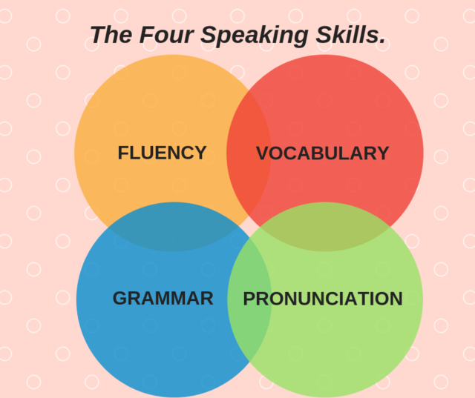

Slide 6
FLUENCY
Fast response
The more you pause the less fluent you are
Sentence connection, not just throwing ideas
Avoid thinking sounds: hmmmm, uh, well, …….
Instead of thinking sound, use sentence like “When I think about it, all I come up with is…..”
Avoid one word sentences, present ideas together and coherently
Create an IDEA BANK

Slide 7
VOCABULARY
Growth of vocabulary
Target: number of words per day
Source of learning: news, songs and TV shows
Is only adding new words to your list of vocabulary enough? No, that’s not enough. You need to know how and where to use them

Slide 8
GRAMMAR
Grammar DOES matter
The fewer mistakes you make, the better your speaking skills will be
Master the major tenses
Sentence structure
Sources: Reading

Slide 9
PRONUNCIATION
word and sentence stress
Intonation
Rhythm
the use of the individual sounds of a language.
A good way to practice your pronunciation is to copy!
Listen to how someone with good pronunciation speaks, and try to imitate them as closely as possible.

Slide 10
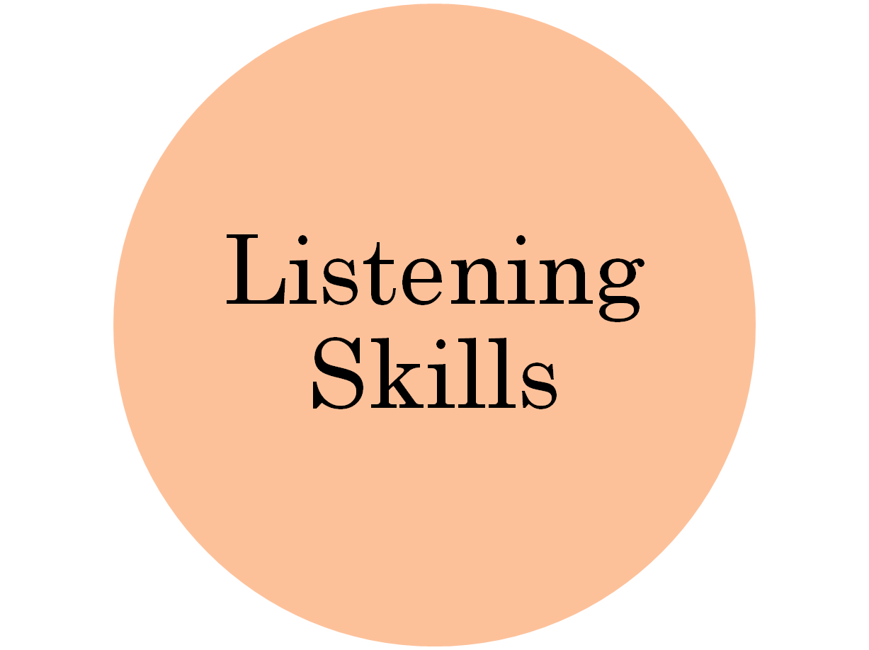

Slide 11
LISTENING SKILLS
Listening skills are ways to help you listen to something more effectively.

Slide 12
HEARING AND LISTENING
Hearing and Listening are not the same!

Slide 13
DIFFERENCE BETWEEN HEARING AND LISTENING
LISTENING
conscious effort to interpret the sounds, requiring concentration of mind.
Listening is voluntary. It takes intention and attention.
Active mental process; attempt to make meaning of what we hear.
Listening is when it reaches your brain.
HEARING
ability of ear to sense sounds around
Non-selective and involuntary process for anyone that CAN be heard
Easy, physical and passive process
Hearing is when the sound reaches your ears

Slide 14
BARRIERS TO LISTENING
Environmental Barriers.
Linguistic Barriers
Psychological Barriers
Physiological Barriers
Perceptual Barriers
Content Barrier
Personal Barriers

Slide 15
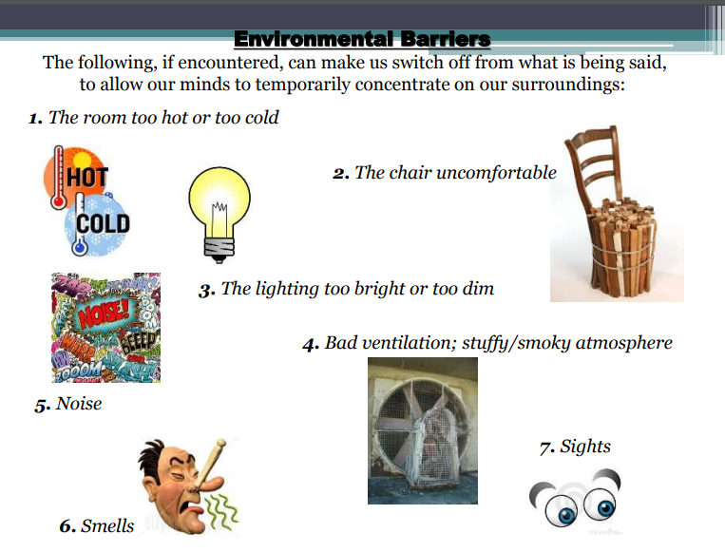

Slide 16
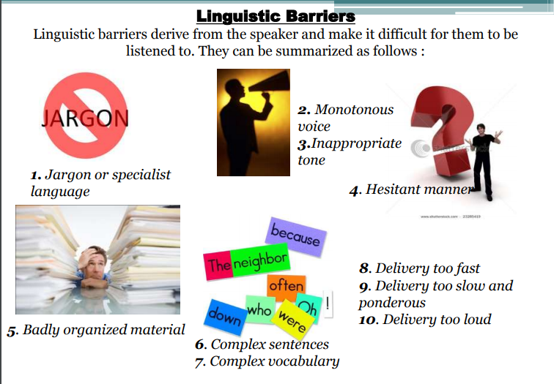

Slide 17
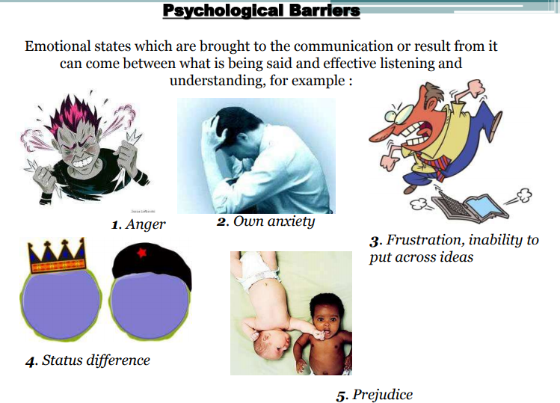

Slide 18
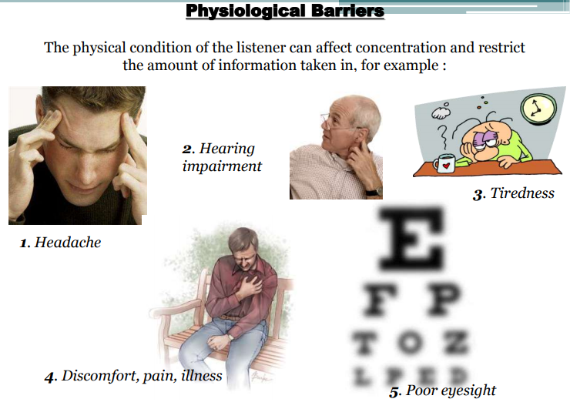

Slide 19
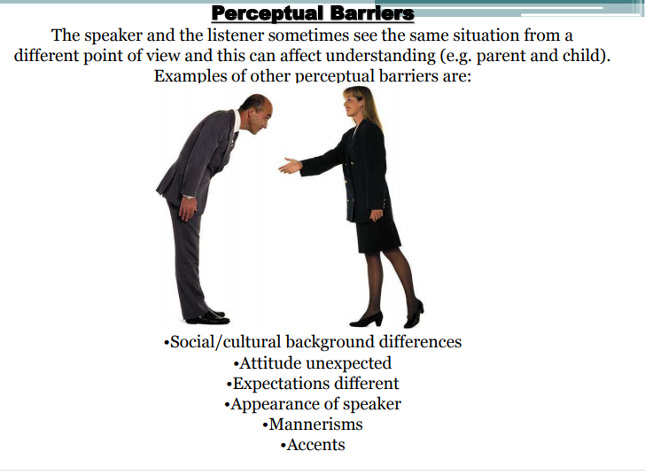

Slide 20
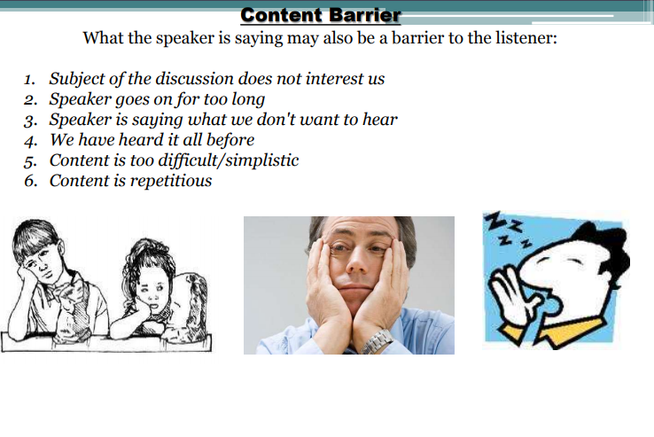

Slide 21
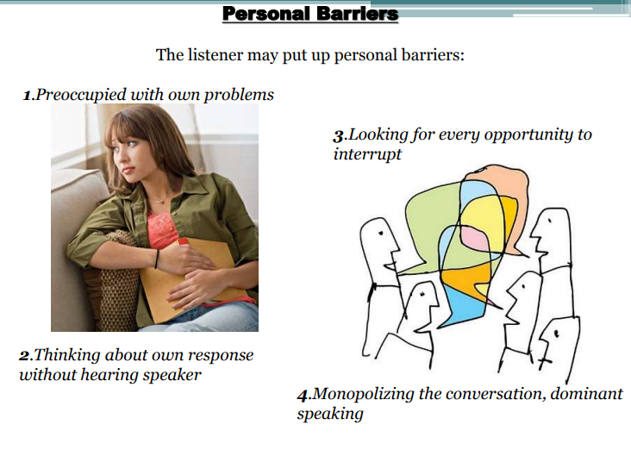

Slide 22
